Slide 1
Instructional Framework: Literacy
Overview of Core Actions

Slide 2
Continuing Our Plan
We will successfully advance our priorities and meet our goals as a district if we rely on a research-based, experience proven plan for improving instruction in every classroom.
Centered on:
What We Teach (Curriculum)
How We Teach (Lesson Structures)
Authentic Literacy
“These three things…a content rich curriculum, sound lessons, and purposeful reading, writing and talking… if even reasonably well-executed, would have more impact than all other initiatives combined….would wholly redefine what public schools can accomplish with children of every socioeconomic stratum.”
Schmoker, Focus, 2011.

Slide 3
What We Teach
“Curriculum may be the single largest factor that determines how many students in a school will learn.” (Marzano, 2003)
Fall 2017:
Began a renewed emphasis on getting our curriculum right
Math, K-12
ELA K-2 and pilot in 3-12
All other content areas focusing on incorporating text every day
Spring 2018:
Purchased aligned curriculum
Eureka Math, K-12
CKLA Skills and Listening & Learning, K-2
Expeditionary Learning, 3-5
Learnzillion, 6-12
Fall 2018:
Continue implementation of math and ELA curricula, with emphasis on text in all other subjects.
Continue walk-throughs with the instructional framework, focused on ensuring fidelity to the implementation of high-quality instructional materials.

Slide 4
How We Teach
“Effective teaching is not some complex combination of talent, technique, or long experience…anyone can immediately implement the most essential, common elements of good teaching with success—and get better at them with practice.” (Schmoker, 2011)
Identifying research-based, time-proven aspects of effective instruction
We must decrease the variability of the effectiveness of instruction from room to room, school to school.
Directly aligns with our curriculum work and complements the IPG indicators

Slide 5
Authentic Literacy
“The clearest differentiator in reading between students who are college ready and students who are not is the ability to comprehend complex texts.” (ACT, Reading Between the Lines, 2006)
Authentic literacy is purposeful reading, writing, and discussion about texts in order to build skills and knowledge.
Will be accomplished by the texts and tasks in the new ELA curriculum
Must be integrated into all other subjects (except math)
Literacy is the spine that holds all of this together.
Every person in our district is a reading teacher.
Unless you are a math teacher, your class should include one or multiple texts every single day.
Improving literacy is an educational issue, an economic issue, and a moral issue.

Slide 6
Instructional Framework
Starter
Engagement
Ending
HOW
WHAT
IPG
Core Action 1
Core Action 2
Core Action 3
IPG
Core Action 1
Core Action 2
Core Action 3
IPG
Core Action 1
Core Action 2
Core Action 3
Notes:
How do you interpret this slide?

Slide 7
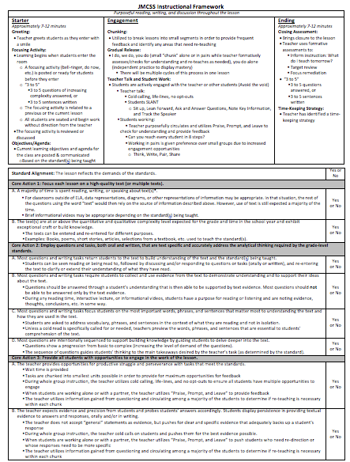
The “How”: Starter, Engagement, Ending
Measuring The “What”:
Core Actions 1, 2, and 3 of the IPG

Slide 8
The “How”
Starter, Engagement, Ending

Slide 10
The “What”

Slide 11
IPG Walkthroughs
Core Action 1: Use of complex text
Core Action 2: Text-based tasks that meet the standards
Core Action 3: Fully engaging students with tasks

Slide 12
The “Core Actions”
Literacy

Slide 13
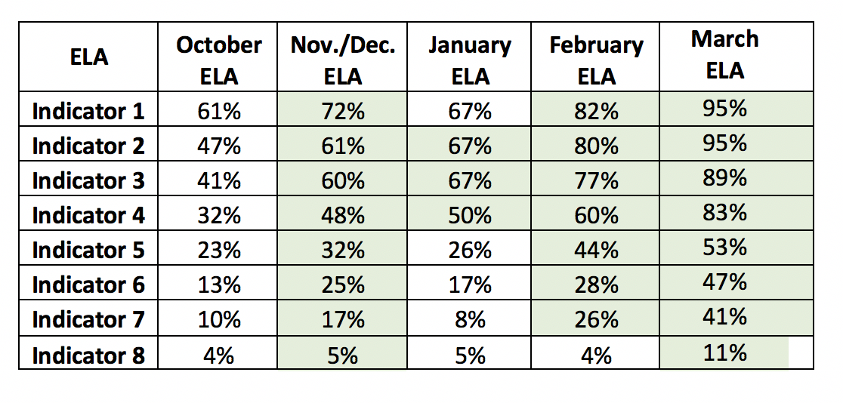
2017 – 2018 District IPG Data: ELA
Fall of 2017, majority of classrooms weren’t getting to Core Action 3
Spring of 2018, progress was made by teachers who began reaching Core Action 3
The key to student growth is meeting all 3
How do we continue to effectively combine “what” we are teaching and “how” we are teaching?

Slide 14
Standard Alignment
Before measuring the quality of the “how” section of the instructional framework, you must first ensure that the lesson is aligned to grade-level standards.
Having an aligned ELA curriculum in grades K-12 will assist teachers with teaching to grade-level standards.
Implementation with fidelity will be key to ensuring the lesson is taught at grade-level.

Slide 15
Core Action 1
Core Action 1 is comprised of two areas of focus:
Reading, writing, or speaking about text(s) during a majority of the lesson.
The qualitative and quantitative complexity of the text.
Can the text be entered and re-entered for multiple purposes?

Slide 16
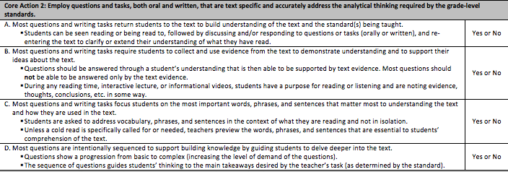
Core Action 2
Core Action 2 focuses on the types of questions and tasks that are text dependent and address analytical thinking.

Slide 17
Core Action 2A
Core Action 2A: Most questions and writing tasks return students to the text to build understanding of the text and the standard(s) being taught.
Can students be seen reading or being read to, followed by discussion and/or responding to questions or tasks (orally and written)?
Are students required to re-enter text(s) to clarify their understanding of what they have read?

Slide 18
Core Action 2B
Core Action 2B: Most questions and writing tasks require students to collect and use evidence from the text to demonstrate understanding and to support their ideas about the text.
Questions should be able to be answered through a student’s own understanding of the text that is then supported by text evidence.
Most questions should not be able to be answered by the text evidence alone.
Students have a purpose for reading or listening and are asked to note evidence, thoughts, conclusions, etc. in some way.

Slide 19
Core Action 2C
Core Action 2C: Most questions and writing tasks focus students on the most important words, phrases, and sentences that matter most to understanding the text and how they are used in the text.
This includes grade-specific vocabulary, phrases, and sentences within the context of the text.
Vocabulary, phrases, and sentences should not be taught in isolation
If addressed in isolation, students should be required to re-enter the text to build their understanding within the text.
If a cold read is not required, teachers should preview the words, phrases, and sentences that will be essential to the student’s comprehension of the text.

Slide 20
Core Action 2D
Core Action 2D: Most questions are intentionally sequenced to support building knowledge by guiding students to delve deeper into the text.
Questions are sequenced from basic to complex.
Questions are sequenced to guide students’ thinking to the main takeaways desired by the teacher’s task (as determined by the demands of the standard).

Slide 21
Core Action 3
Core Action 3 focuses on providing all students with opportunities to engage in the work of the lessons.
Reaching Core Action 3 is the key to student growth.

Slide 22
Core Action 3A
Core Action 3A: The teacher provides opportunities for productive struggle and perseverance with tasks that meet the standards.
Teacher provides wait time
“Chunking” is utilized to maximize opportunities for students to respond and for teachers to provide feedback
Teacher utilizes cold calling.
Teacher utilizes “Praise, Prompt, and Leave” while students are working.
Teacher gauges student understanding through the use of formative assessments and adjusts lesson accordingly.

Slide 23
Core Action 3B
Core Action 3B: The teacher expects evidence and precision from students and probes students’ answers accordingly. Students display persistence in providing textual evidence to answers and responses, orally and/or written.
The teacher does not accept general responses, but pushes for clear and specific evidence that supports the student’s response.
The teacher utilizes cold calling during whole group instruction and pushes students to provide the best evidence possible.
When students are working, the teacher utilizes “Praise, Prompt, and Leave” to push students who need re-direction or whose responses need to be more specific.
Teacher gauges student understanding through the use of formative assessments and adjusts lesson accordingly.

Slide 24
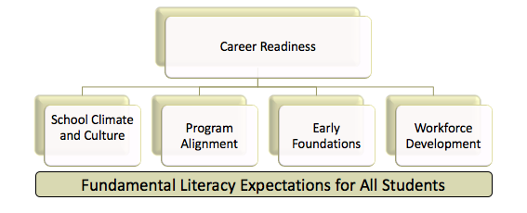
Working Our Plan
By improving our “what” and our “how” while
emphasizing literacy in all areas, we will meet our goals.
This is it.
We must pursue these and not compromise their simplicity, clarity, and focus.

